Slide 1
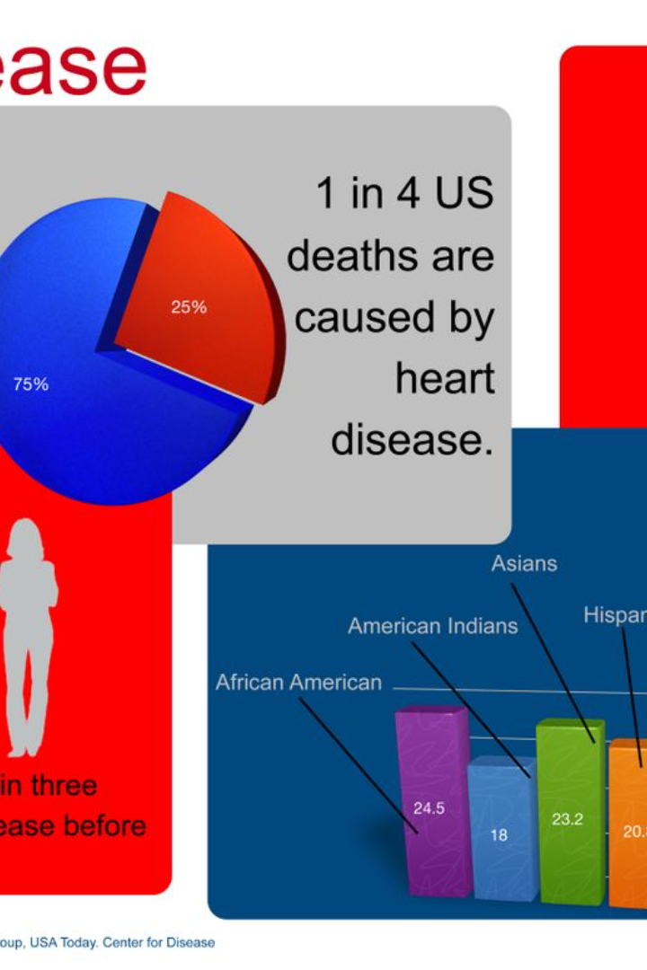
Introduction to Heart Disease
An overview of heart disease and its impact

Slide 2
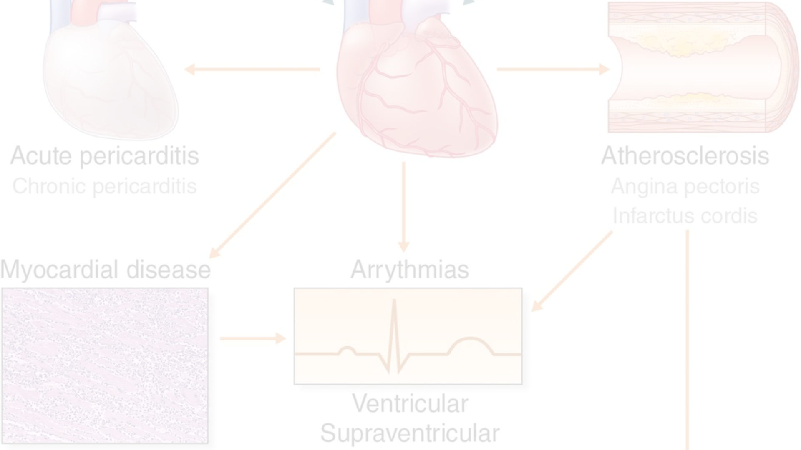
Risk Factors for Heart Disease
1
High Blood Pressure
2
Smoking
3
Obesity
Increases the risk of heart disease
Linked to heart disease and other health issues
One of the leading risk factors

Slide 3
Symptoms and Warning Signs
Common Symptoms
Warning Signs
Seek Medical Attention
Don't ignore persistent symptoms
Chest pain, shortness of breath
Urgent care may be required

Slide 4



Diagnostic Tests for Heart Disease
Echocardiogram
Blood Test
CT Scan
Visualizing the heart's function
Checking for specific markers
Detailed imaging of the heart

Slide 5
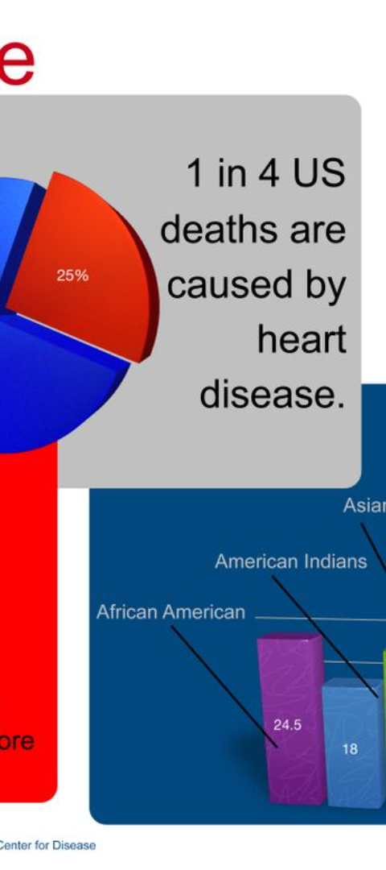
Data Analysis Techniques
Machine Learning
Statistical Modeling
Analyzing large sets of patient data
Identifying patterns and correlations
Predictive Analytics
Forecasting disease progression

Slide 6
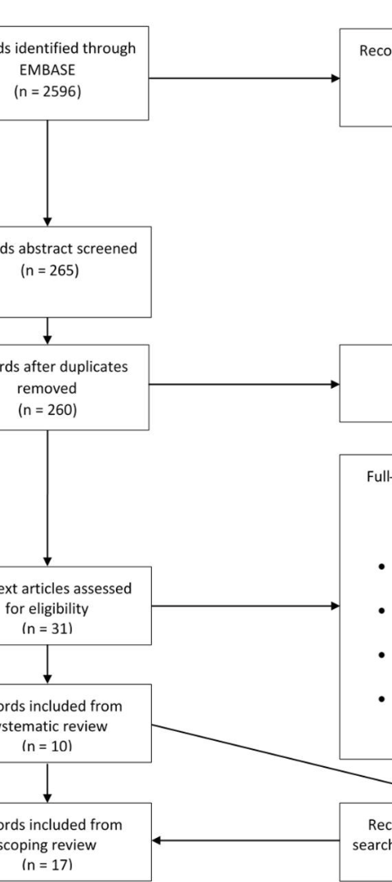
Case Studies and Examples
1
Patient Profile
Age, lifestyle, medical history
2
Treatment Plan
Customized cardiac care options
3
Recovery Progress
Outcome and long-term management

Slide 7
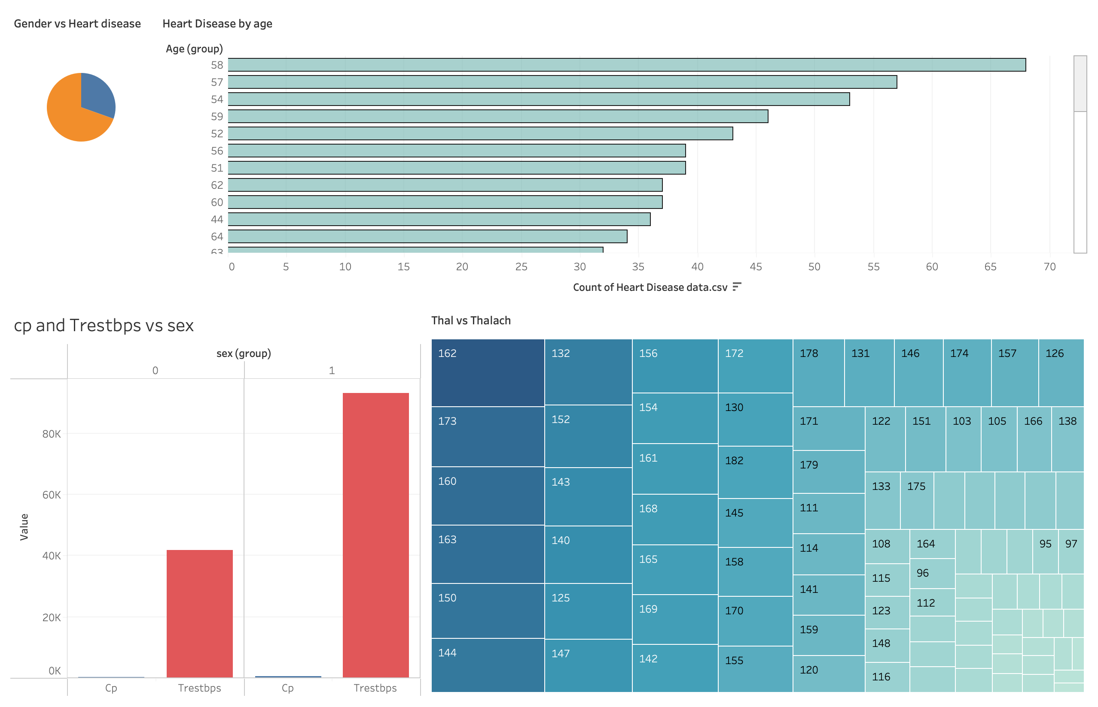
Tableau
Dashboard

Slide 8
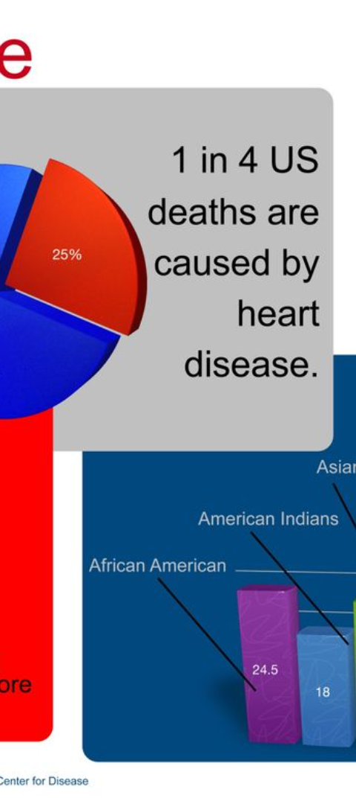



Conclusion and Key Takeaways
Educational Insights
Understanding the impact of prevention
Early Intervention
Recognizing the significance of diagnostics
Future Research
Exploring innovative treatments and technologies

